Slide 1

Infineon-NP Research Collaboration Project:
Automotive Battery Thermal Runaway Prediction
Dr. Wesley Poh
ATV SYS SAE CS AI
October 2026

Slide 2
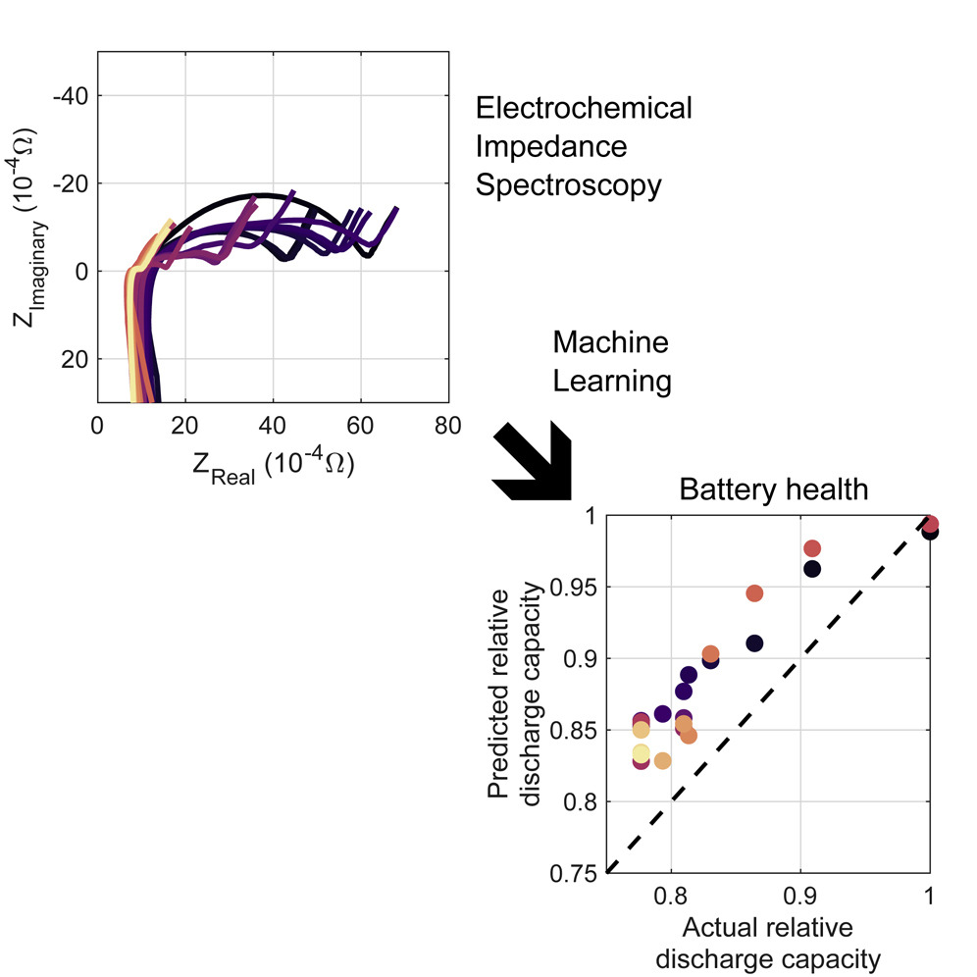
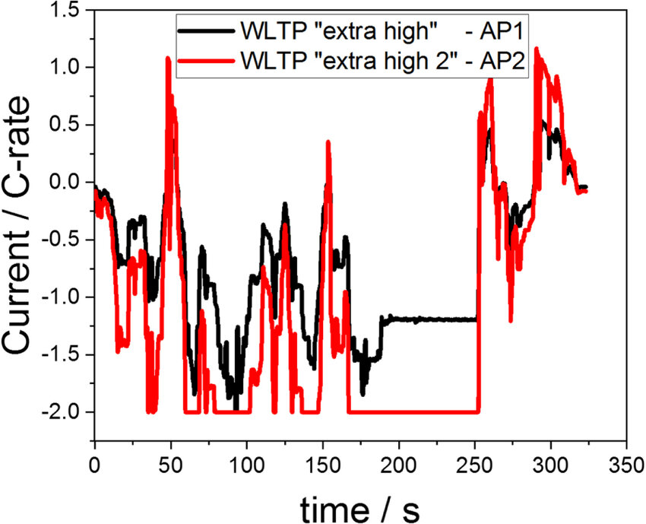
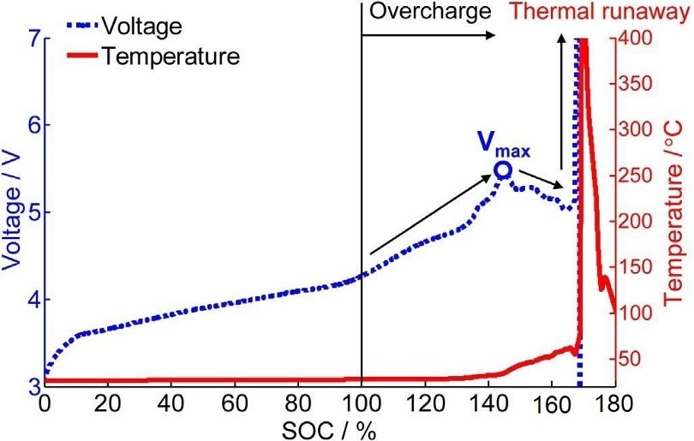
Objectives
Conduct rigorous testing to gather datasets for developing a predictive model capable of identifying early warning signs (precursors) of thermal runaway (TR) in lithium-ion cells before catastrophic failure occurs.
The project will utilise controlled battery cycling to induce degradation and capture high-resolution electrochemical data for analysis based on the following:
i) Experiment Set-Up and Safety
ii) Data Generation (Cycling Regimes)
iii) Data Analysis and Modelling

Slide 3
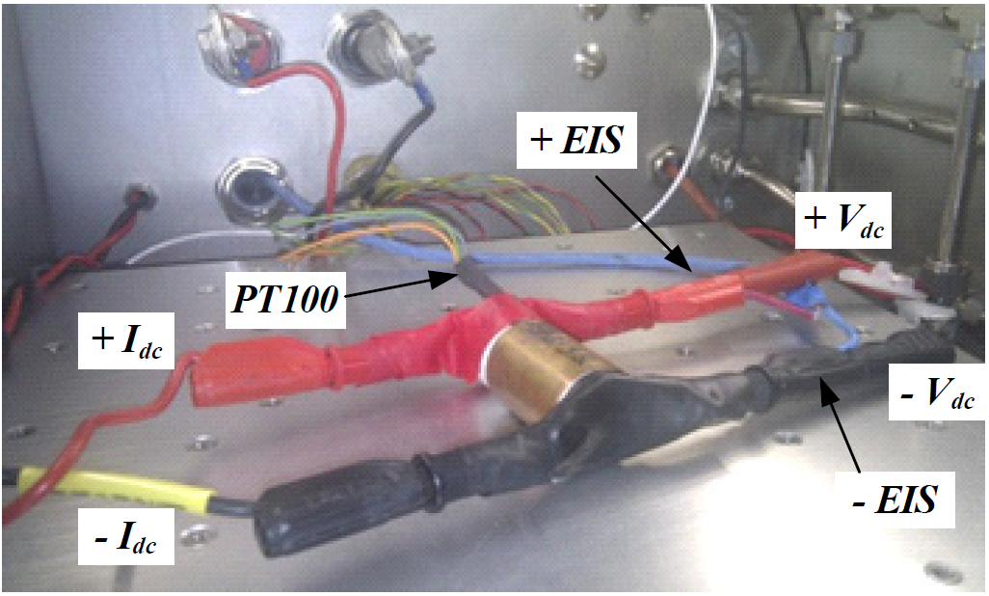
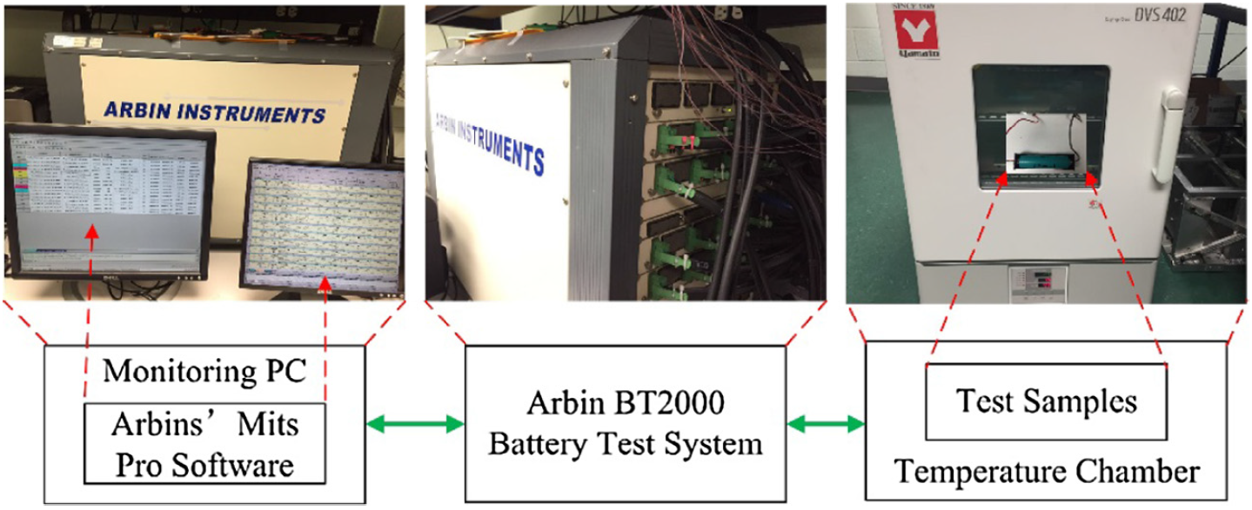
Electrochemical Impedance Spectroscopy (EIS)
EIS is a reliable method for characterising and modelling the behaviour of lithium-ion batteries (LIBs) for thermal runaway (TR) detection.
The small-signal impedance of the LIBs is determined by applying a small sinusoidal current or voltage, and measuring the amplitude and phase shift of the output voltage or current, respectively.
Typically, EIS measurements are performed using small current, ranging from 50 mHz to 10 kHz frequency.
Test Bench Example:

Slide 4
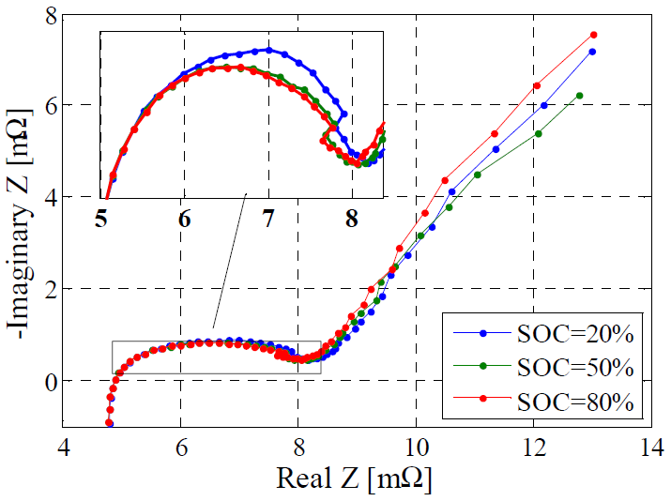
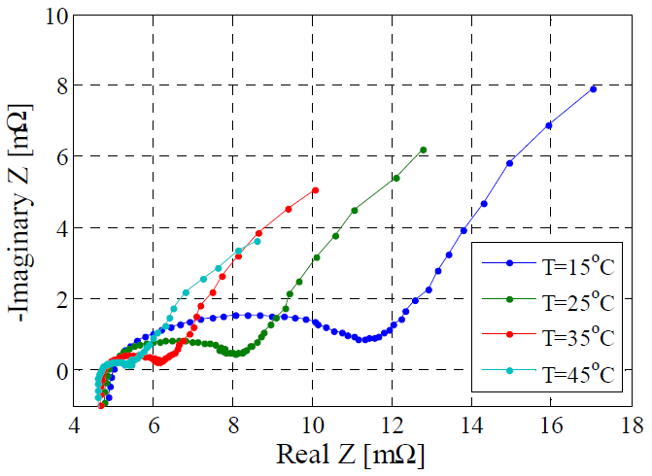
Electrochemical Impedance Spectroscopy (EIS)
Dependence of the impedance spectra on the SOC; T = 25 °C
Dependence of the impedance spectra on the temperature; SOC = 50%

Slide 5
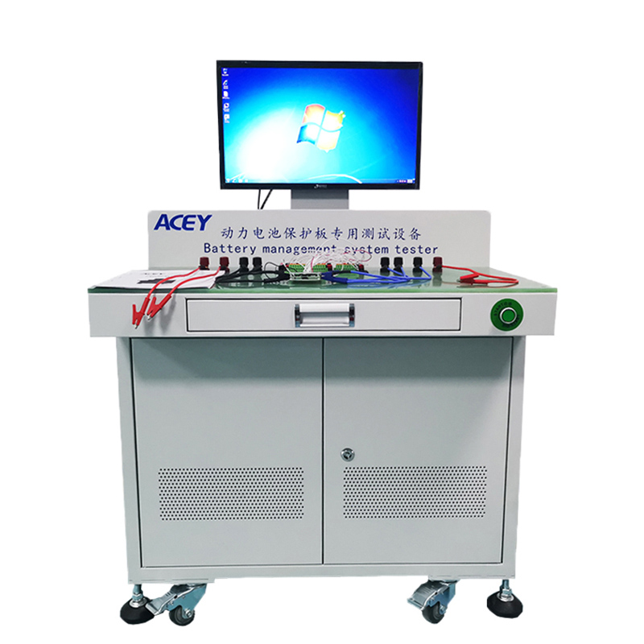
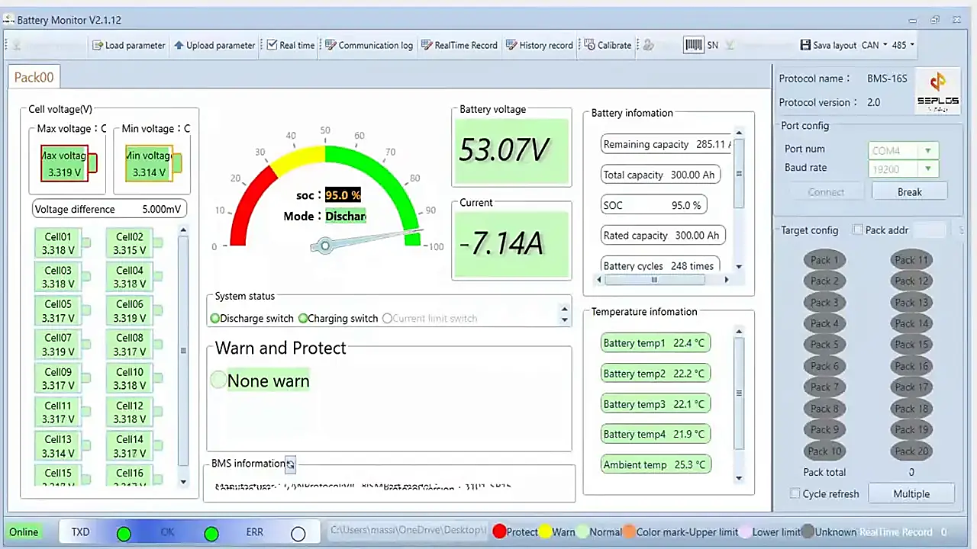
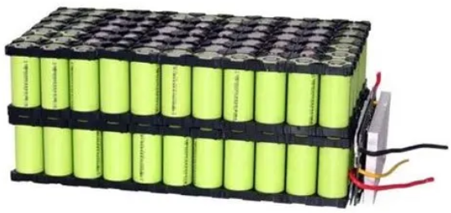
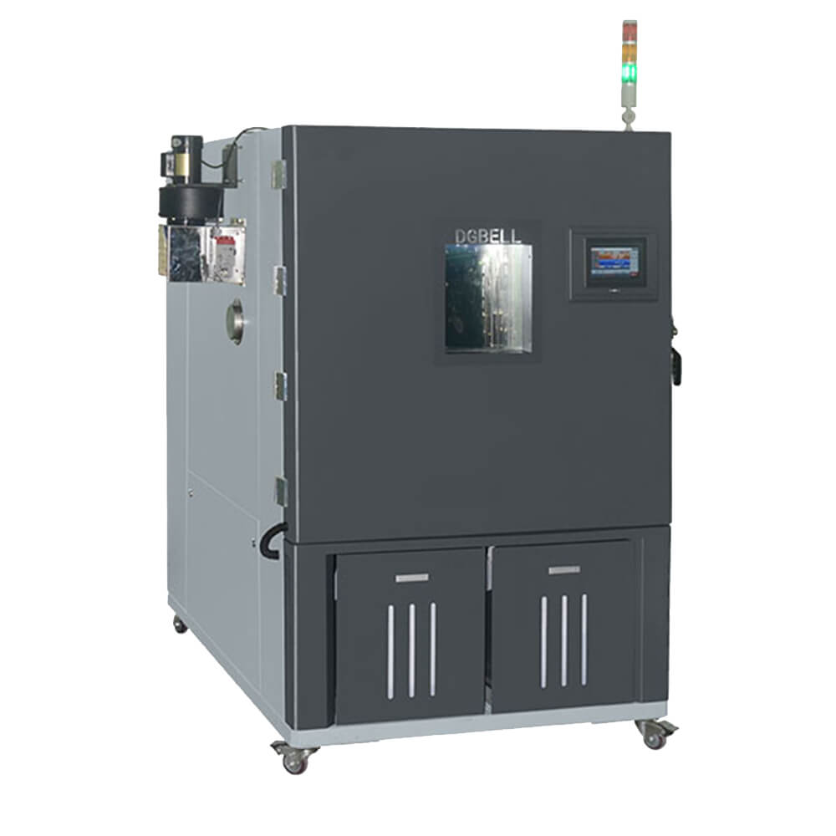
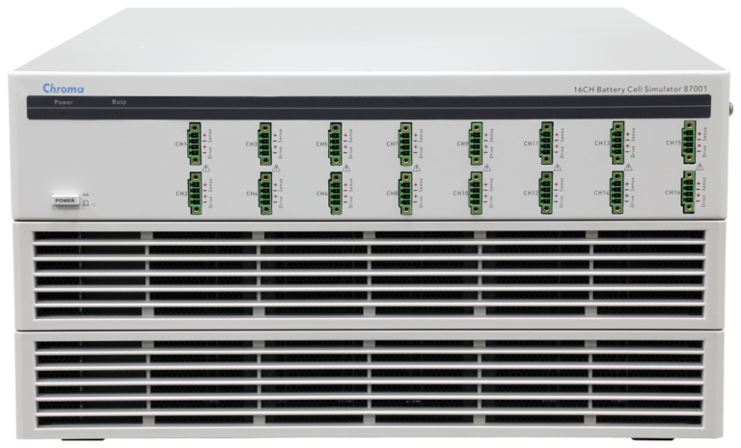
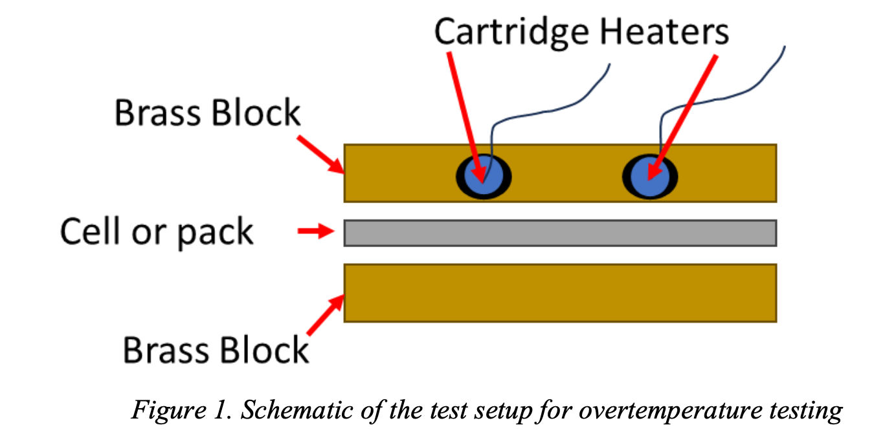
Experiment Set-Up
Battery Monitoring GUI on Host PC
Host PC for Monitoring & Control
Battery Pack
Chroma 87001 Battery Cycler
Real-time test updates
Interior of Chamber:
DGBELL BTH-408B Thermal Chamber
Wired communication and control

Slide 6
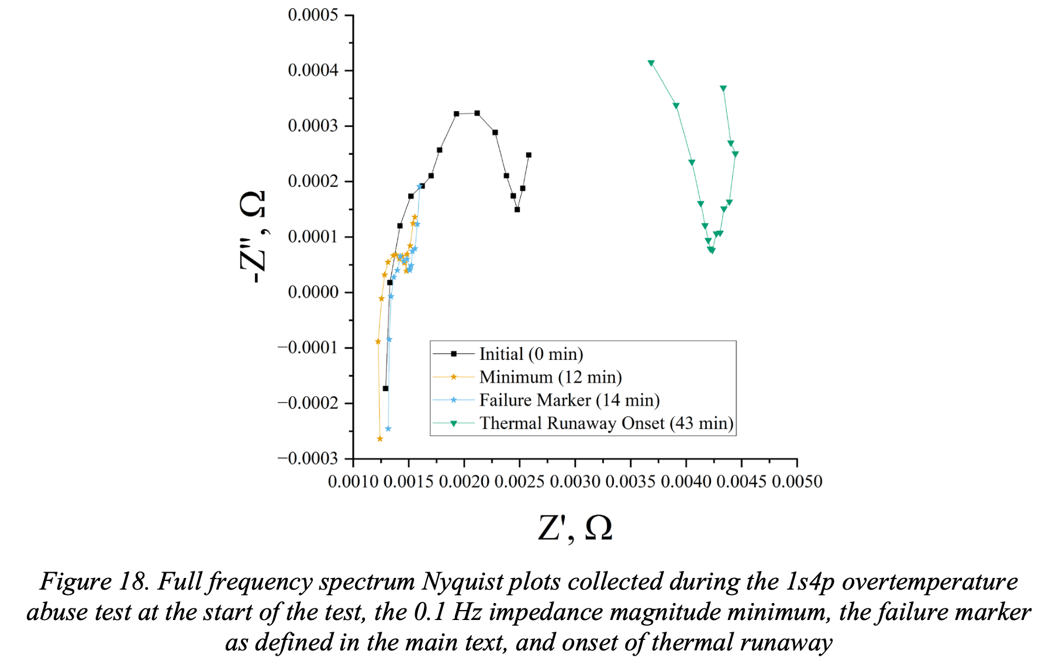
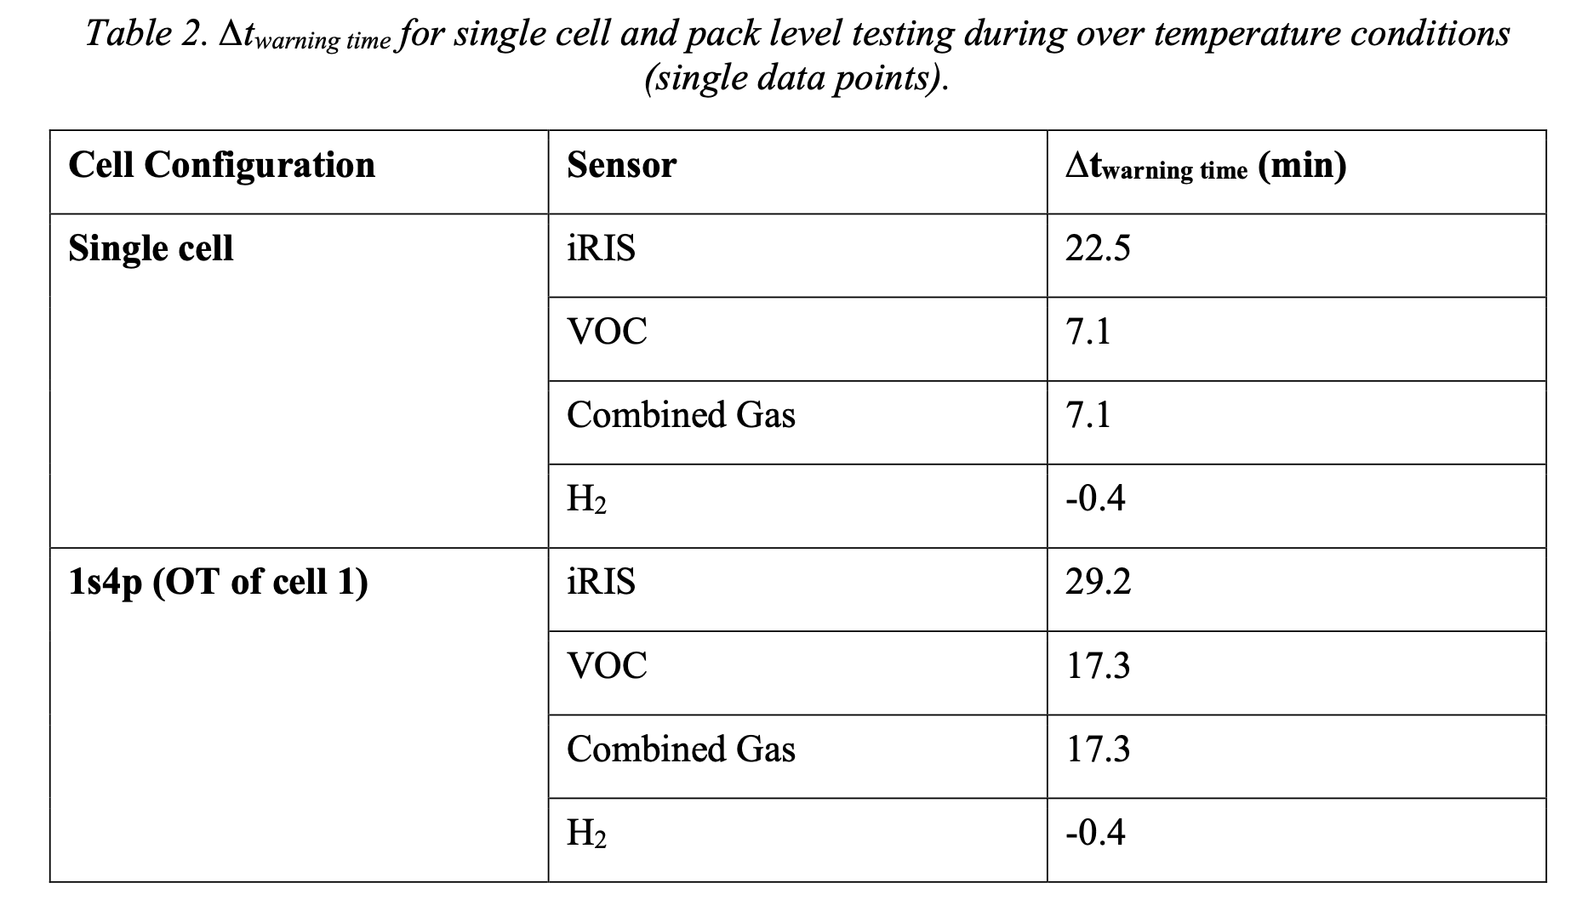
Over-temperature Trigger Test

Slide 7
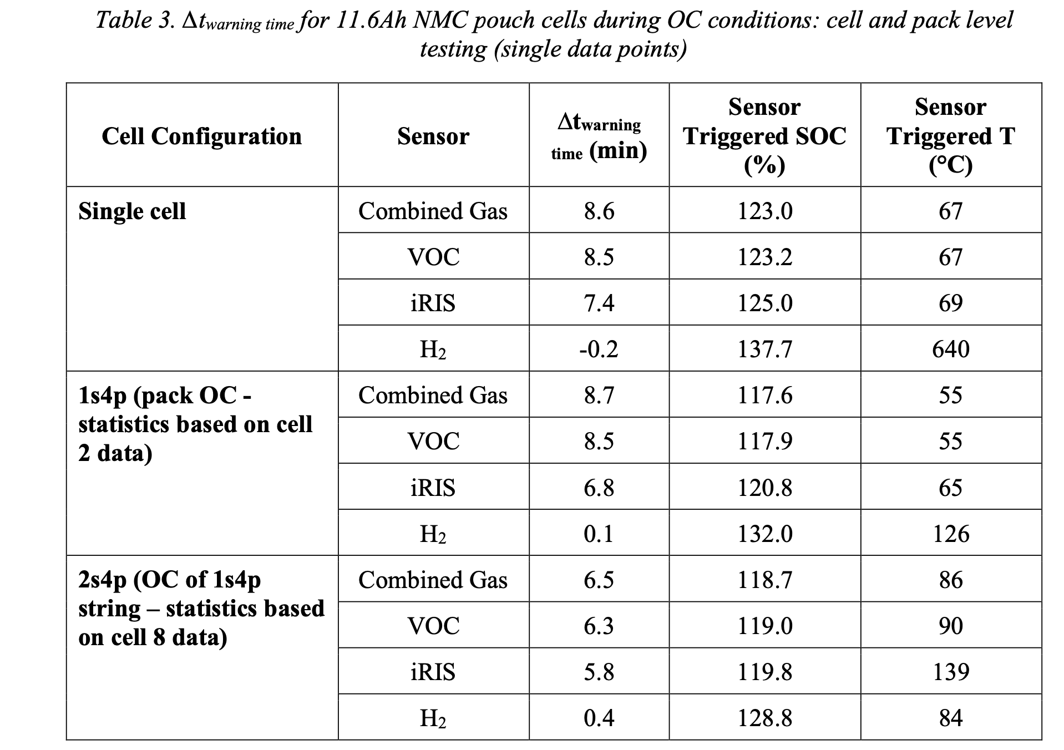
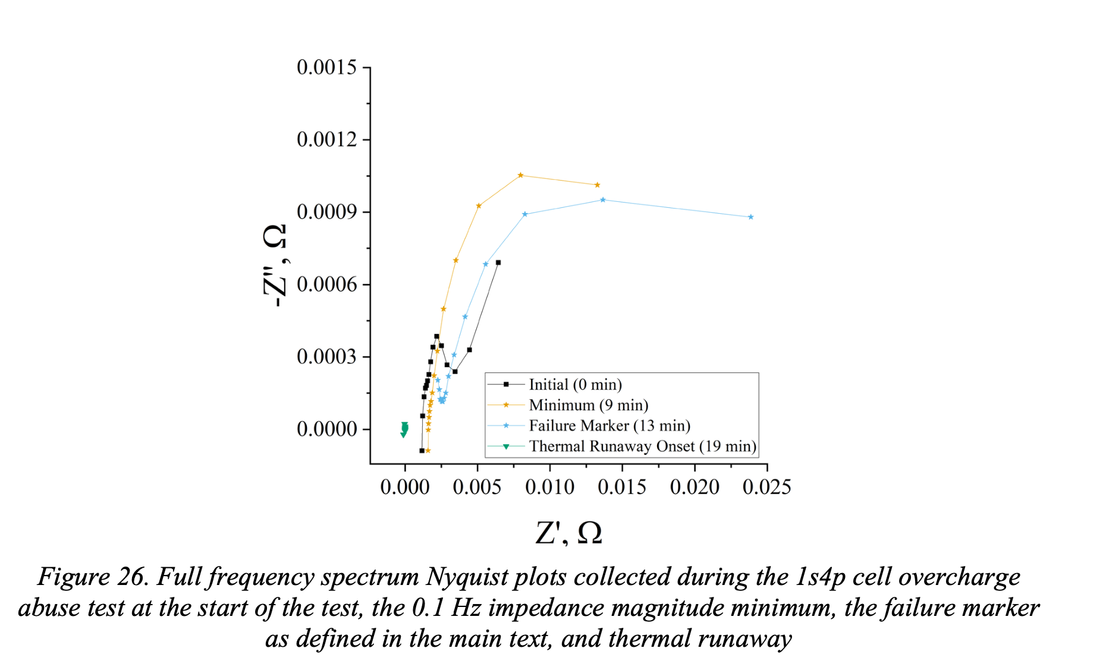
Overcharge Trigger Test

Slide 8
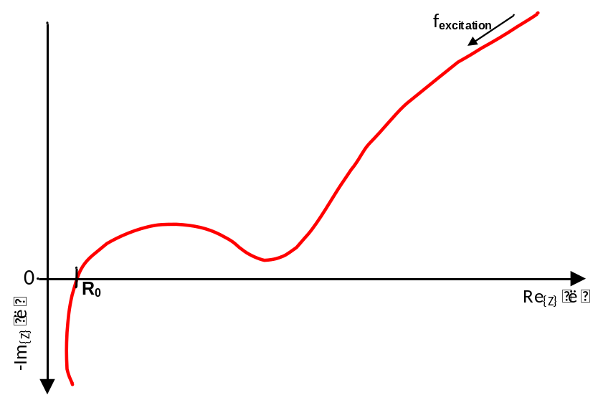
Nyquist plot from EIS (electrochemical impedance spectroscopy) testing
Impedance spectrum of a Li-Ion battery vs frequency coverage
Relation – Impedance spectrum vs EIS use case
mHz range
Relevant for SoX*
SoH
High Hz range
Low Hz range
Mid Hz range
higher Hz range
Lower Hz range
mid Hz range
Temp
SoC
Power
*Depending on cell chemistry, structure,
use case, etc.
*Depending on cell chemistry, structure,
use case, etc.
mHz till Low Hz range
  Gen1 EIS TLE9012DQU
mHz till Mid Hz range
  Gen2 EIS TLE9018DQK
Higher frequencies
  Gen3/4 EIS TLE9024DQK/TLE90xxEQK
The higher the impedance frequency, e.g., 1 kHz, the more crosstalk effects of the wiring of the battery cell itself are overlaying the measurement.
SoH is the source for SoC algorithm calibration over aging and power estimations. Hence, EIS implementation for SoH is valuable.

Slide 9

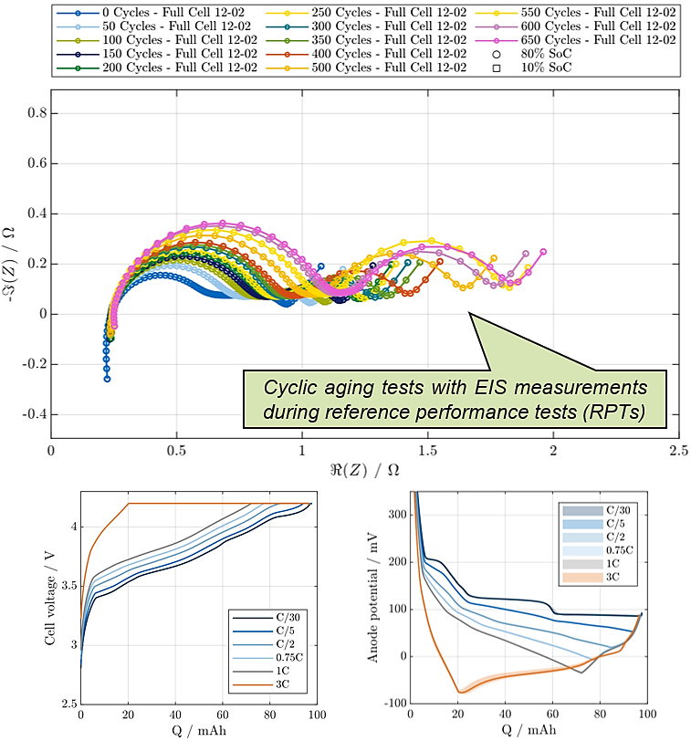
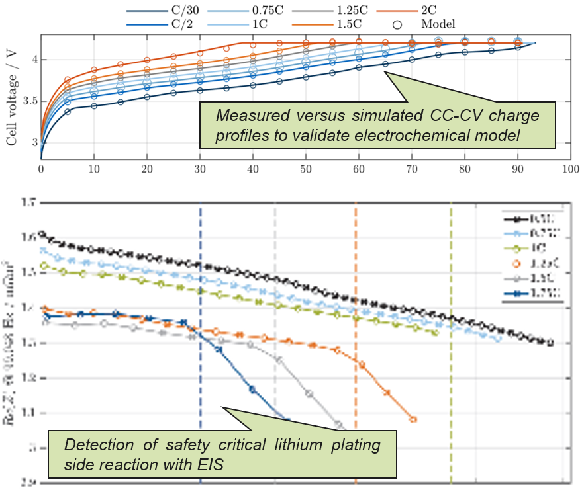
Using EIS data from aging cells
From aging data to TR prediction model…
Characterisation of cells
in frequency and time domain
Model parameterisation and algorithm development
Aging tests on LFP / NMC cells aim to identify aging-sensitive cell parameters via EIS.
Validation of a real-time model running on AURIX™.
Detection of lithium plating using EIS.

Slide 10


Types of EIS in HV batteries and our available solutions
Pack-Level EIS
Cell-Level EIS
Requires V/I sensing of the pack only.
Typically performed by the pack montoring IC.
Typically performed for intercept-point (typically high Hz) ranges for estimating State-of-Power.
PSOCTM SPM
Requires V/I sensing of every individual cell.
Can be performed using single-channel AFE, multi-channel AFE, or highly synchronous AFEs.
Typically performed for mHz to mid-Hz ranges due to challenging cross-talking and magnetic coupling.
TLE90xx
R1
1
V_{dd}
Excitation
Circruit
R_{sense}
2
PWM
Current
Excitaion
1
R2
AC decoupling
circuit
3
V_{sense}
2
V_{sense}
4
3
I_{sense}
I_{sense}
4
R_{sense}
5
R_{load}
6
5
Available Infineon Solutions:
PSOCTM SPM: Pack monitoring IC with High-Voltage Precision Analog and capability to measure up to 10 kHz pack EIS.
Available Infineon Solutions:
TLE9010: Single-channel EIS with AC-decoupled ADC and capability to measure up to 7 kHz EIS.
TLE9018 + PSOCTM HVPA: Synchronous EIS measurement with Iso UART (up to 333 Hz).

Slide 11







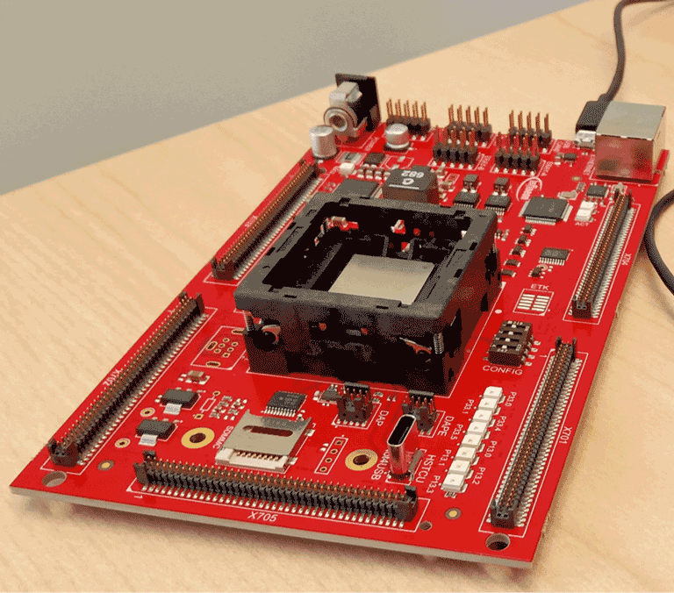

Predictive (AI) Model Development-to-Deployment Workflow (for TCx CPU / TriCore)
AURIX™ TCF Debugger
ACS
ACS
OneEye GUI
Pick One
Data Preparation
Integrate, Build and Test Model
Run and Print Results
Model Training
Model Validation
Build CPU/TriCore Appl. (GCC)
Model Export
ONNX2C
Software Flashing
AURIX™ TCx
Develop, Evaluate & Export
Build & Flash
Real-Time Execution & Observation

Slide 12
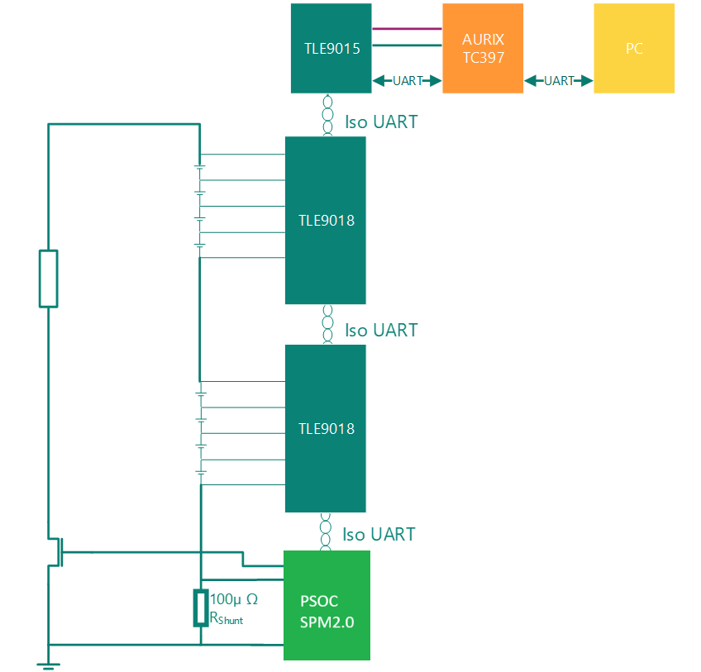
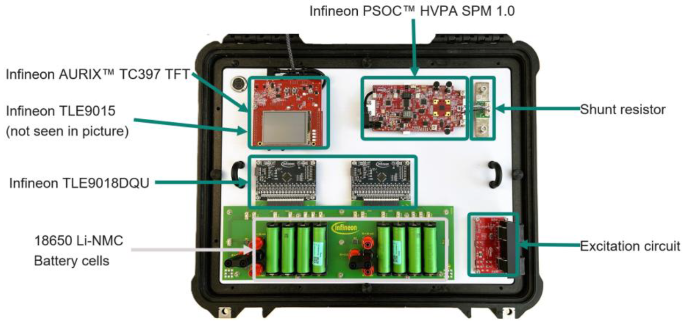
EIS Demo Kit
Choose a quick test, selected points or a frequency sweep.
Acquire synchronized cell voltage and current across the chain.
Calculate per-cell impedance on AURIX™.
Use Nyquist and Bode plots for battery prognostics.

